Slide 1
Cyber Attacks and Risk Management
BCA
Cloud Computing & Information Security
Mr. Sukhdev Singh
Asst. Professor
Computer Science & IT
Jagannath University, Delhi (NCR)

Slide 2
Cyber Security Concepts
Social Engineering and Malware
What is phishing?
Phishing is when attackers send scam emails (or text messages) that contain links to malicious websites. The websites may contain malware (such as ransomware) which can sabotage systems and organisations. Or they might be designed to trick users into revealing sensitive information (such as passwords), or transferring money.
Cont..

Slide 3
Cyber Security Concepts
Social Engineering and Malware
What is phishing?
Phishing emails can hit an organisation of any size and type. You might get caught up in a mass campaign (where emails are sent indiscriminately to millions of inboxes), or it could be the first step in a targeted attack against your company, or a specific employee. In these targeted campaigns, the attacker uses information about your employees or company to make their messages even more persuasive and realistic. This is usually referred to as spear phishing.
Cont..

Slide 4
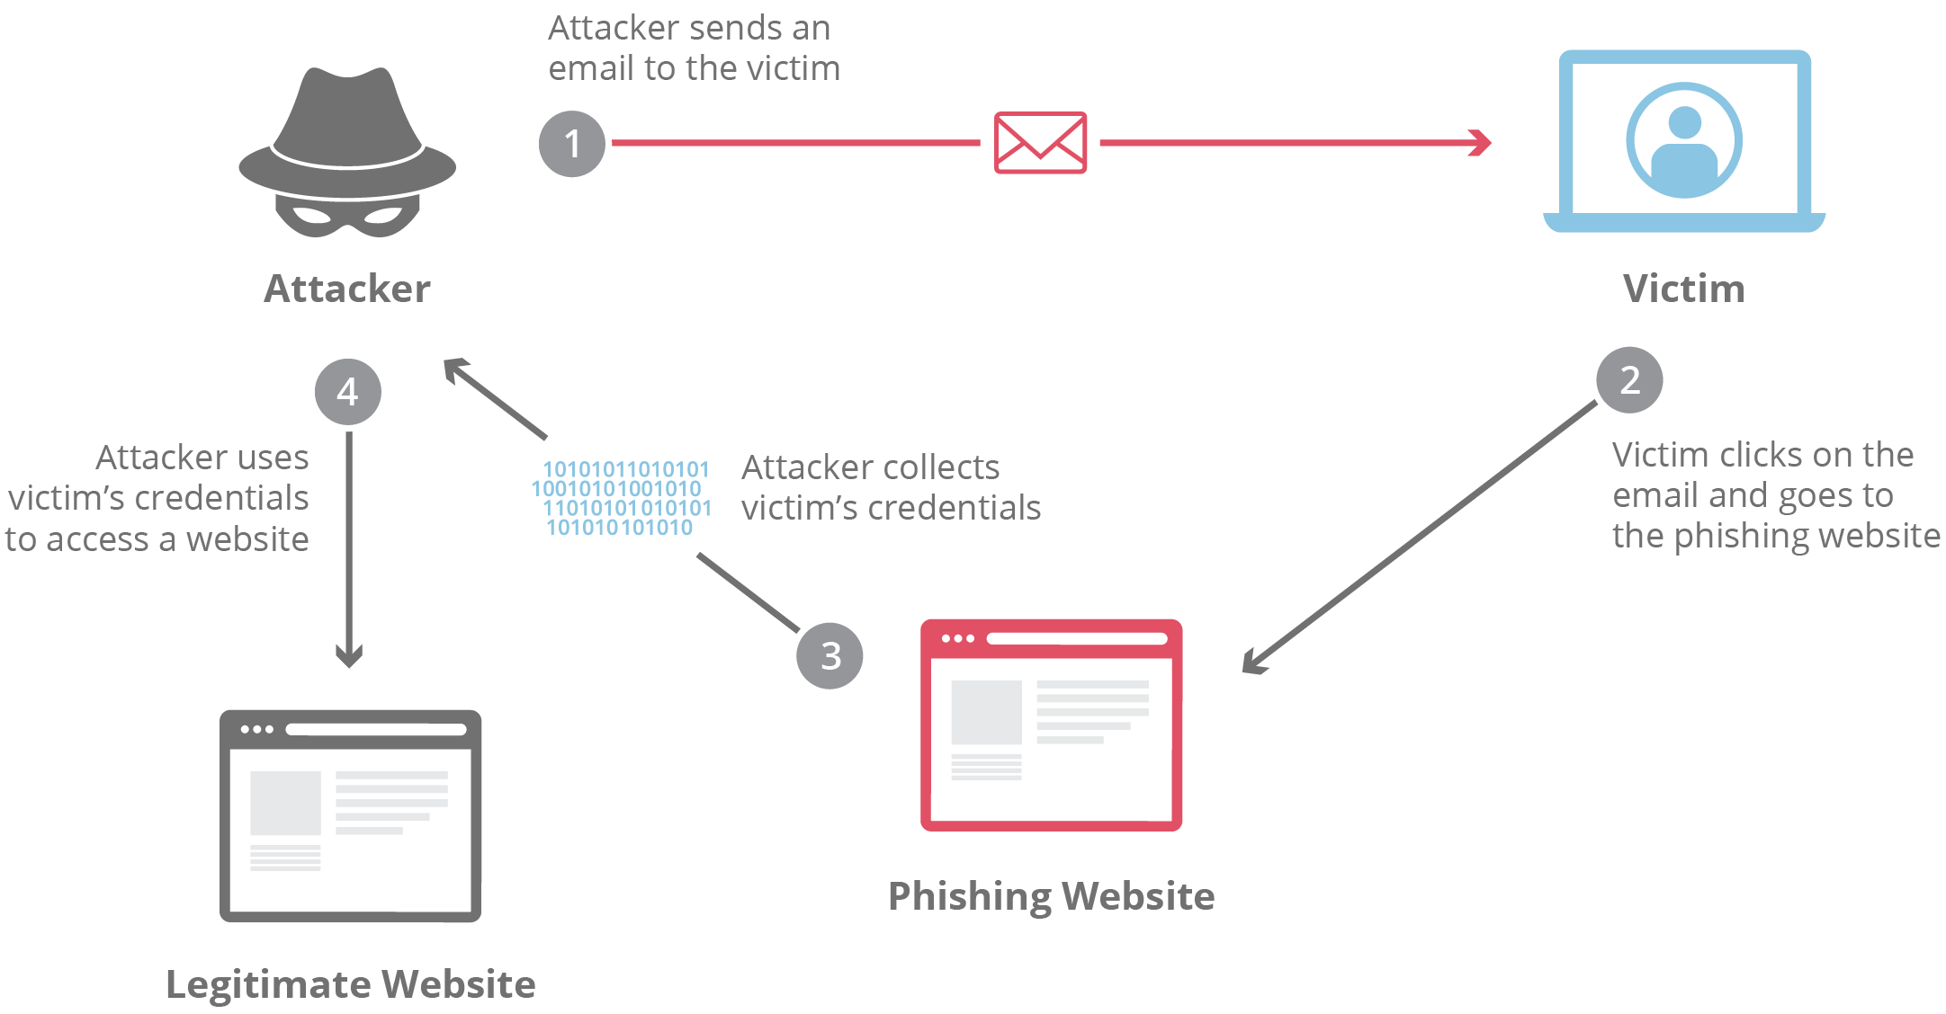
Cyber Security Concepts
Social Engineering and Malware
What is phishing?

Slide 5
Cyber Security Concepts
Social Engineering and Malware
How is phishing carried out?
The most common examples of phishing are used to support other malicious actions, such as on-path attack and cross-site scripting attacks. These attacks typically occur via email or instant message, and can be broken down into a few general categories. It’s useful to become familiar with a few of these different vectors of phishing attacks in order to spot them in the wild.

Slide 6
Cyber Security Concepts
Social Engineering and Malware
How is phishing carried out?
Advanced-fee scam
This common email phishing attack is popularized by the “Nigerian prince” email, where an alleged Nigerian prince in a desperate situation offers to give the victim a large sum of money for a small fee upfront. Unsurprisingly, when the fee is paid, no large sum of money ever arrives. The interesting history is that this type of scam has been occurring for over a hundred years in different forms.

Slide 7
Cyber Security Concepts
Social Engineering and Malware
How is phishing carried out?
Account deactivation scam
By playing off the urgency created in a victim who believes an important account is going to be deactivated, attackers are able to trick some people into handing over important information such as login credentials. Here’s an example: the attacker sends an email that appears to come from an important institution like a bank, and they claim the victim’s bank account will be deactivated if they do not take action quickly. The attacker will then request the login and password to the victim’s bank account in order to prevent the deactivation

Slide 8
Cyber Security Concepts
Social Engineering and Malware
How is phishing carried out?
Website forgery scam
This type of scam is commonly paired with other scams such as the account deactivation scam. In this attack, the attacker creates a website that is virtually identical to the legitimate website of a business the victim uses, such as a bank. When the user visits the page through whatever means, be it an email phishing attempt, a hyperlink inside a forum, or via a search engine, the victim reaches a website which they believe to be the legitimate site instead of a fraudulent copy. All information entered by the victim is collected for sale or other malicious use.

Slide 9
Cyber Security Concepts
Social Engineering and Malware
How is phishing carried out?
What is spear phishing
This type of phishing is directed at specific individuals or companies, hence the term spear phishing. By gathering details or buying information about a particular target, an attacker is able to mount a personalized scam. This is currently the most effective type of phishing, and accounts for over 90% of the attacks.

Slide 10
Cyber Security Concepts
Social Engineering and Malware
How is phishing carried out?
What is clone phishing
Clone phishing involves mimicking a previously delivered legitimite email and modifying its links or attached files in order to trick the victim into opening a malicious website or file. For example, by taking an email and attaching a malicious file with the same filename as the original attached file, and then resending the email with a spoofed email address that appears to come from the original sender, attackers are able to exploit the trust of the initial communication in order to get the victim to take action.

Slide 11
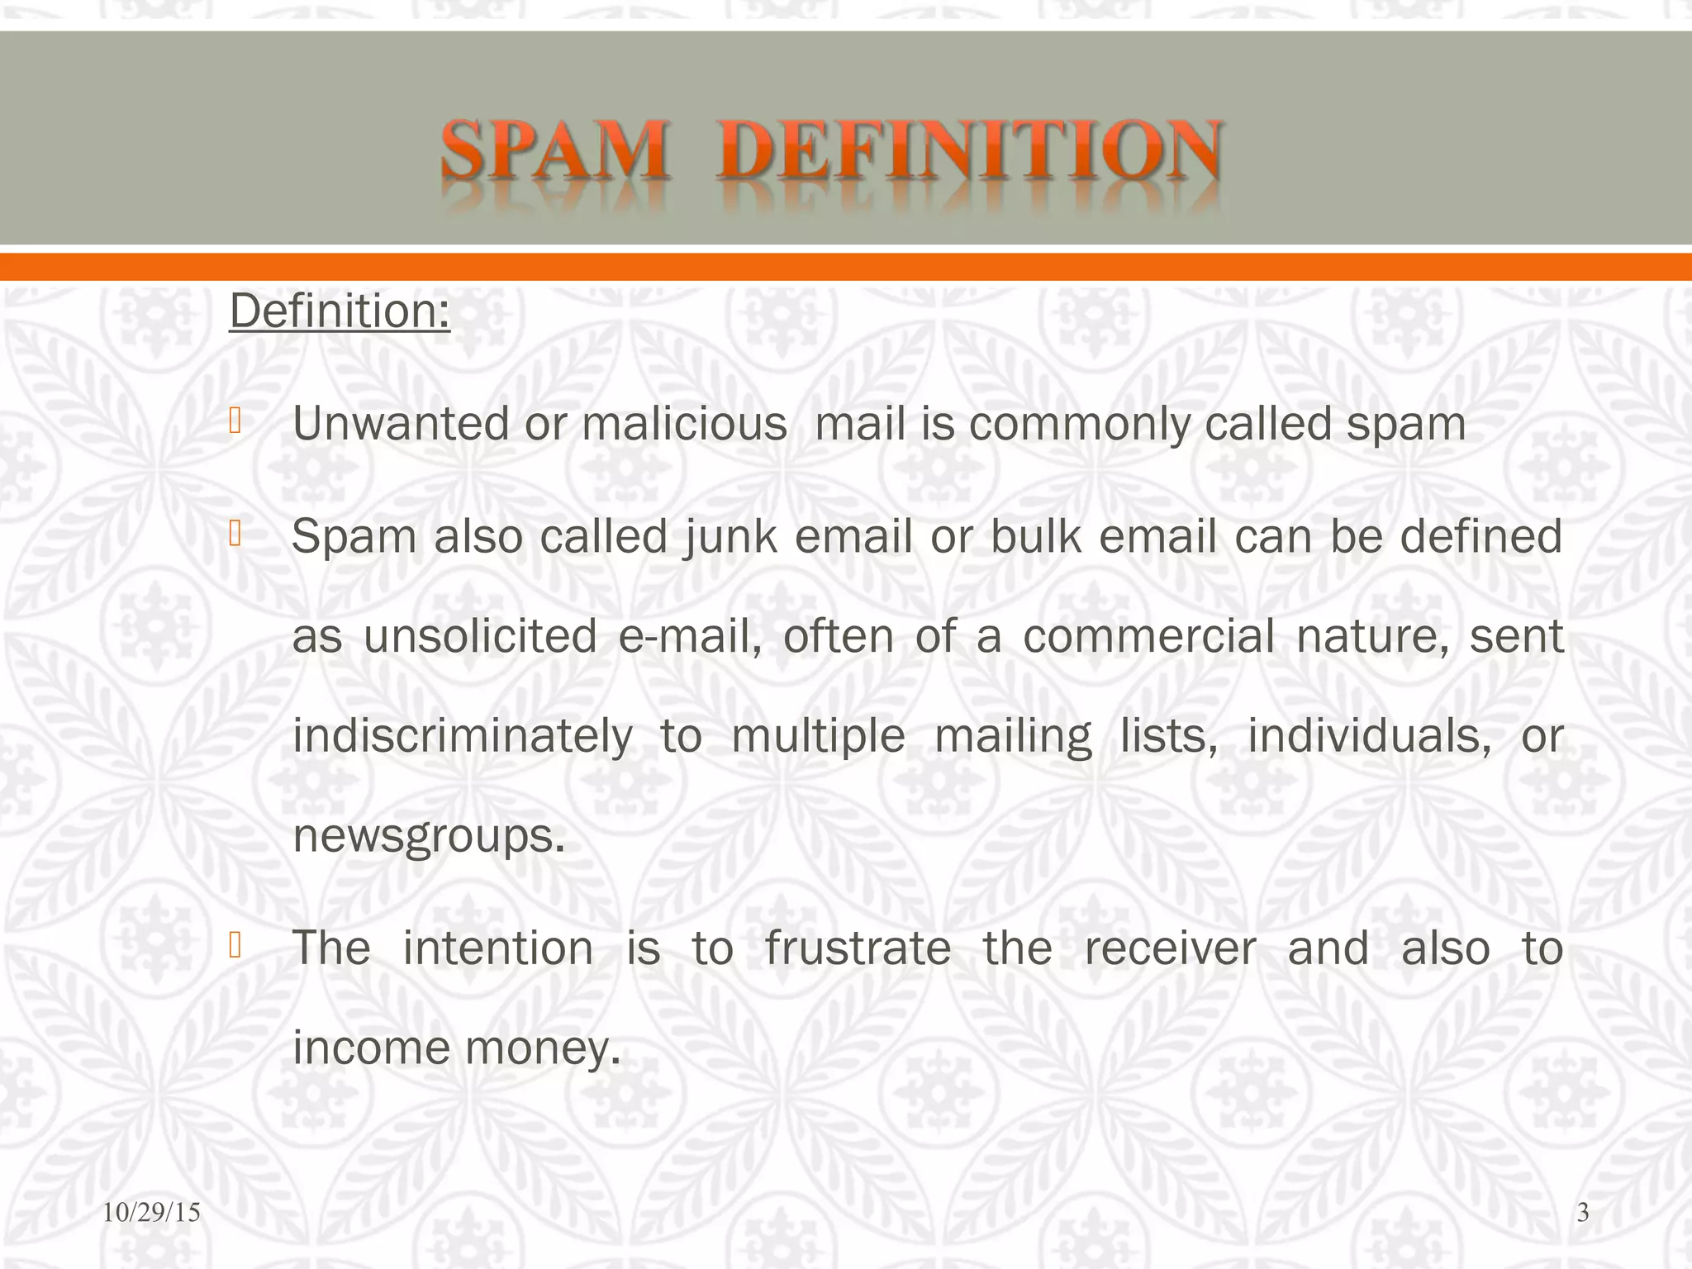
Cyber Security Concepts
Social Engineering and Malware
SPAM

Slide 12
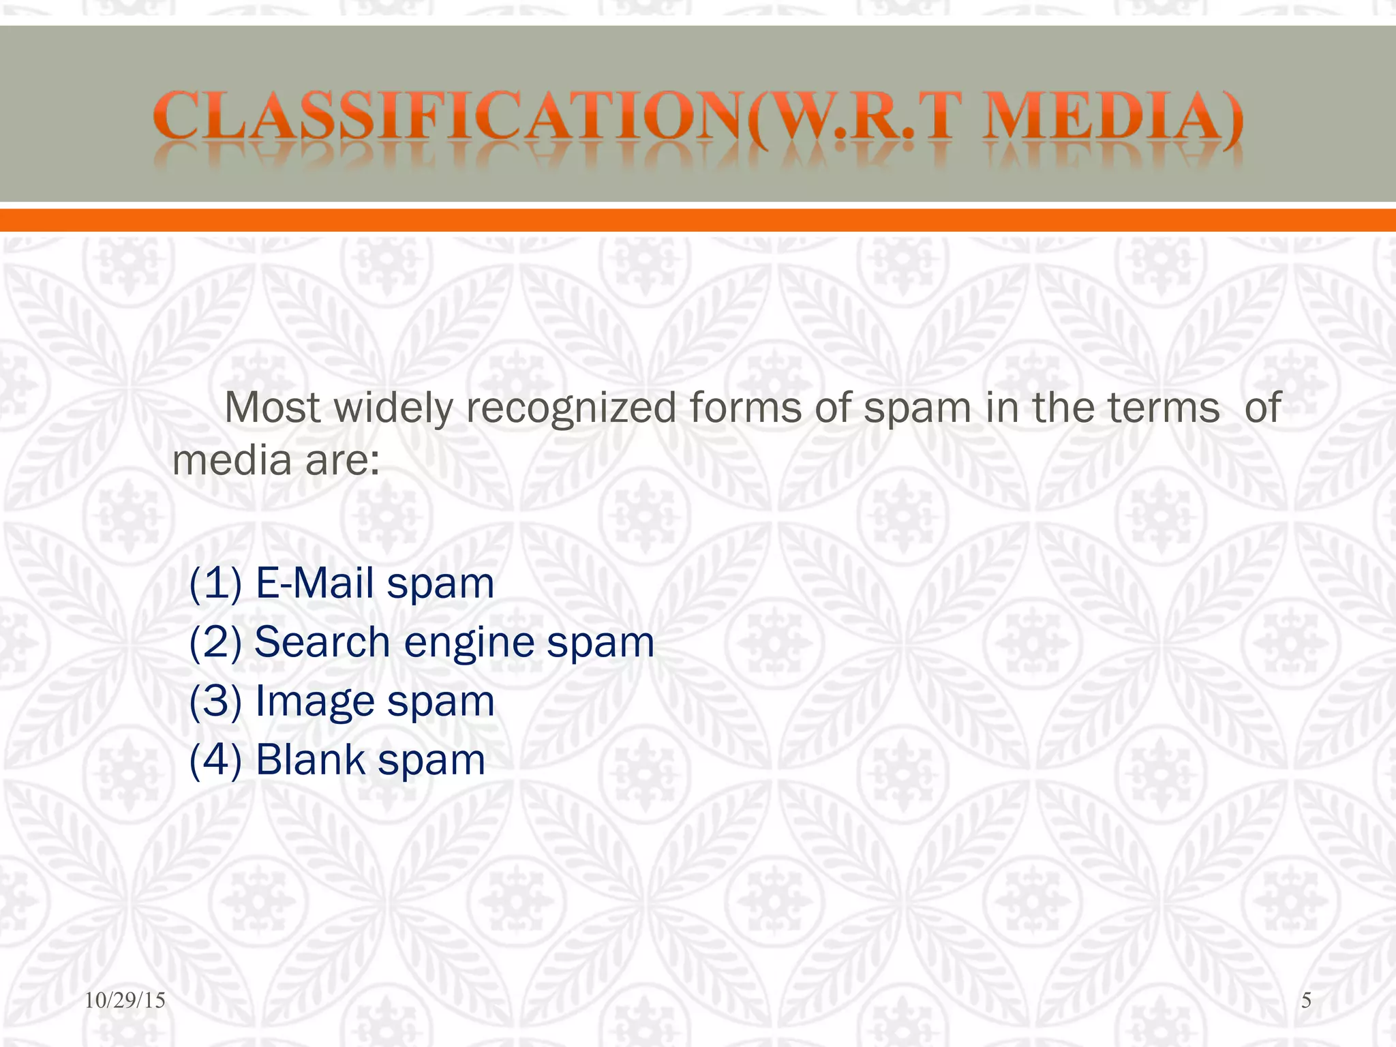
Cyber Security Concepts
Social Engineering and Malware
SPAM

Slide 13
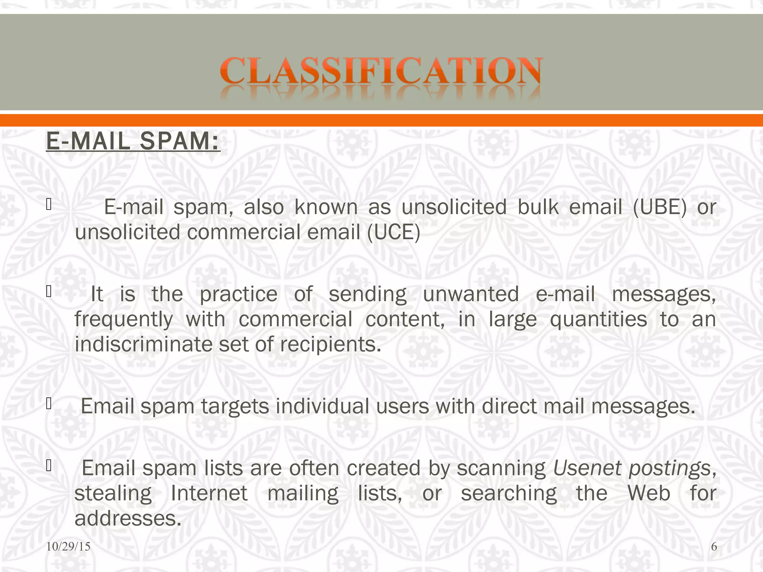
Cyber Security Concepts
Social Engineering and Malware
SPAM

Slide 14
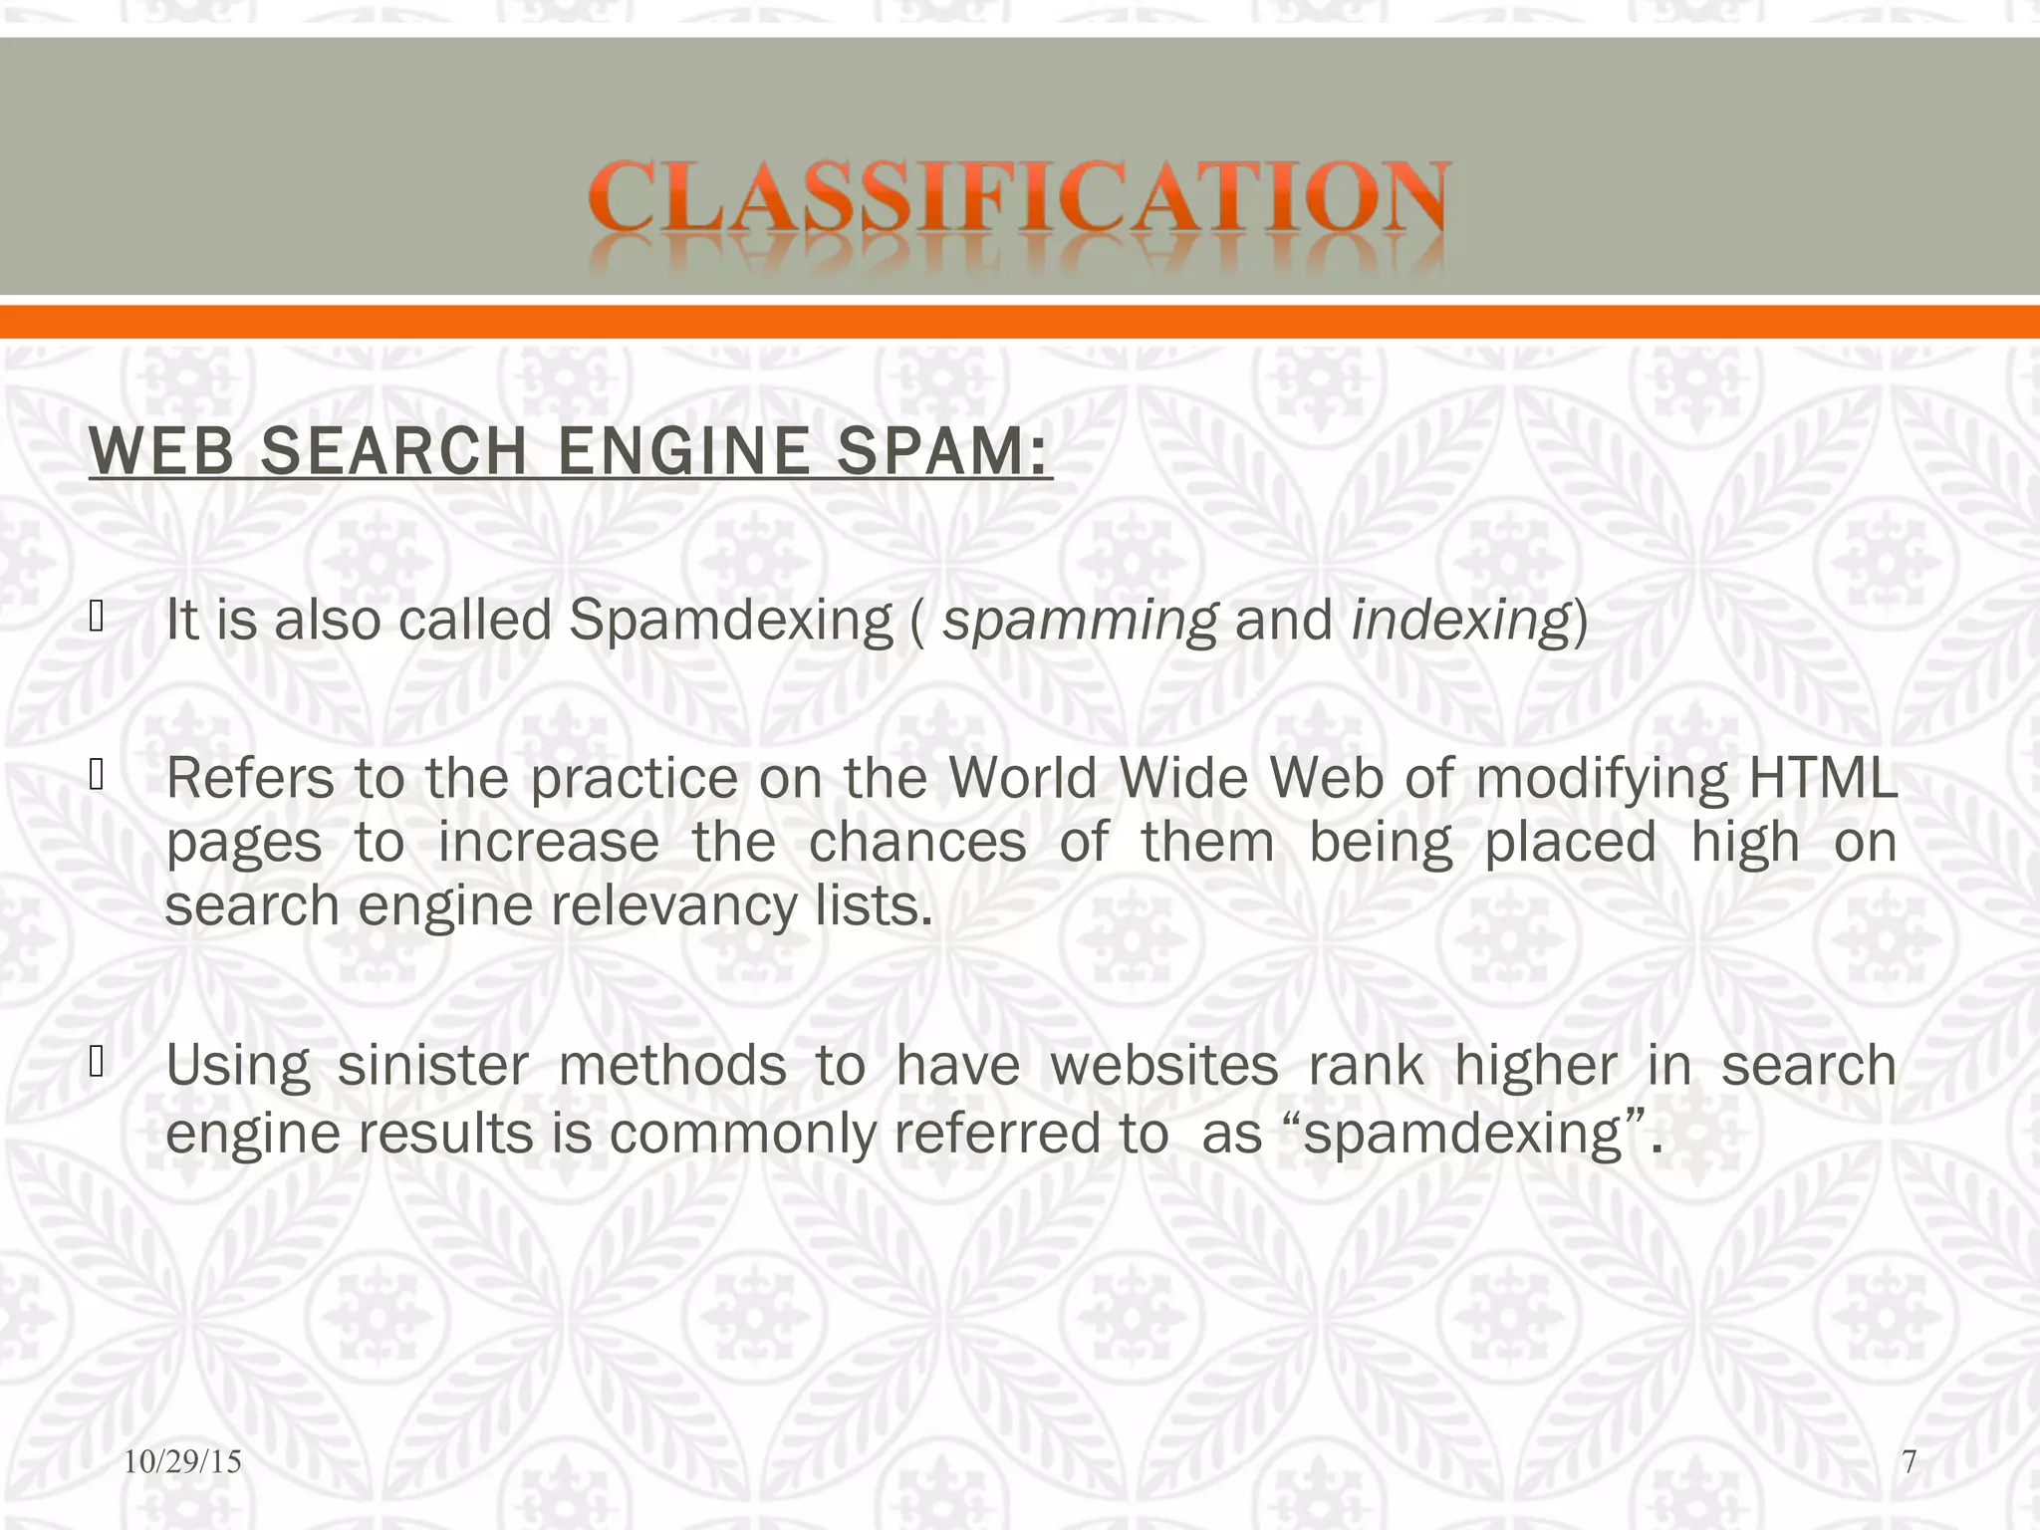
Cyber Security Concepts
Social Engineering and Malware
SPAM

Slide 15
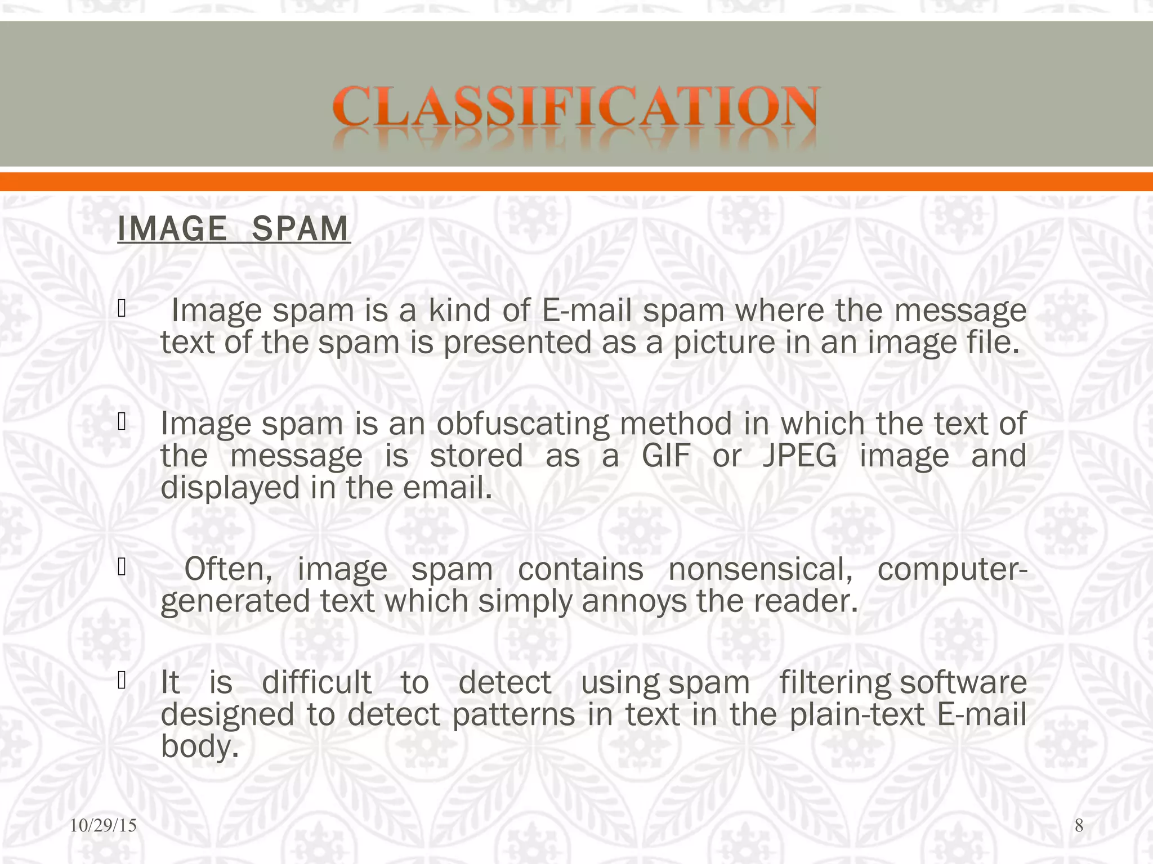
Cyber Security Concepts
Social Engineering and Malware
SPAM

Slide 16
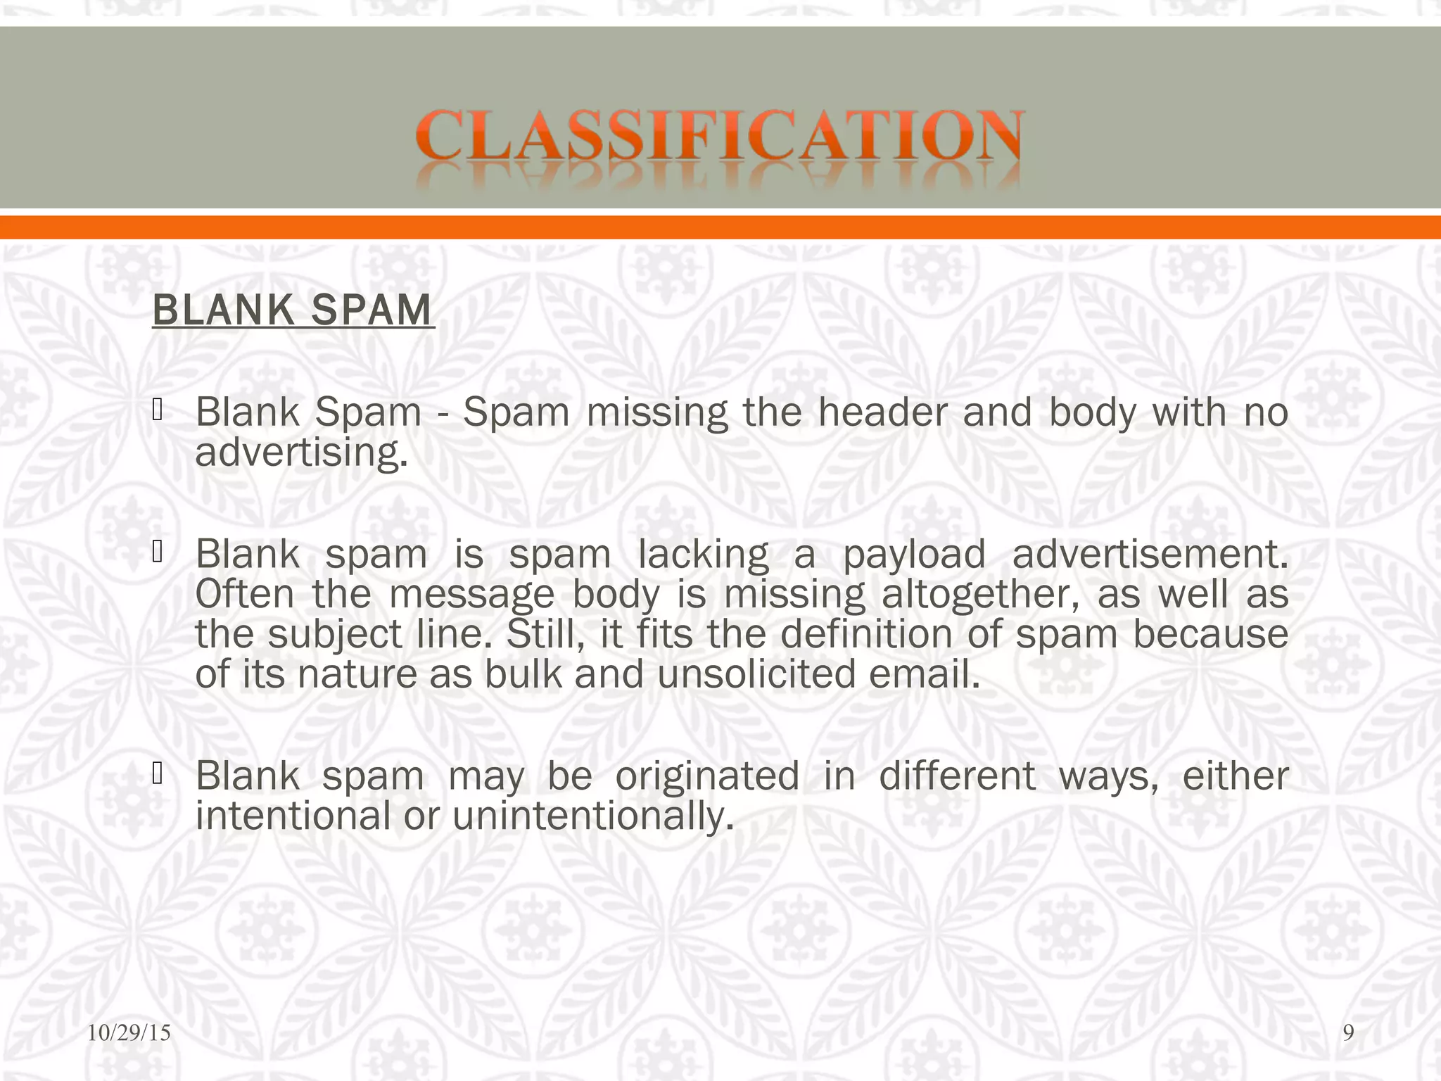
Cyber Security Concepts
Social Engineering and Malware
SPAM

Slide 17
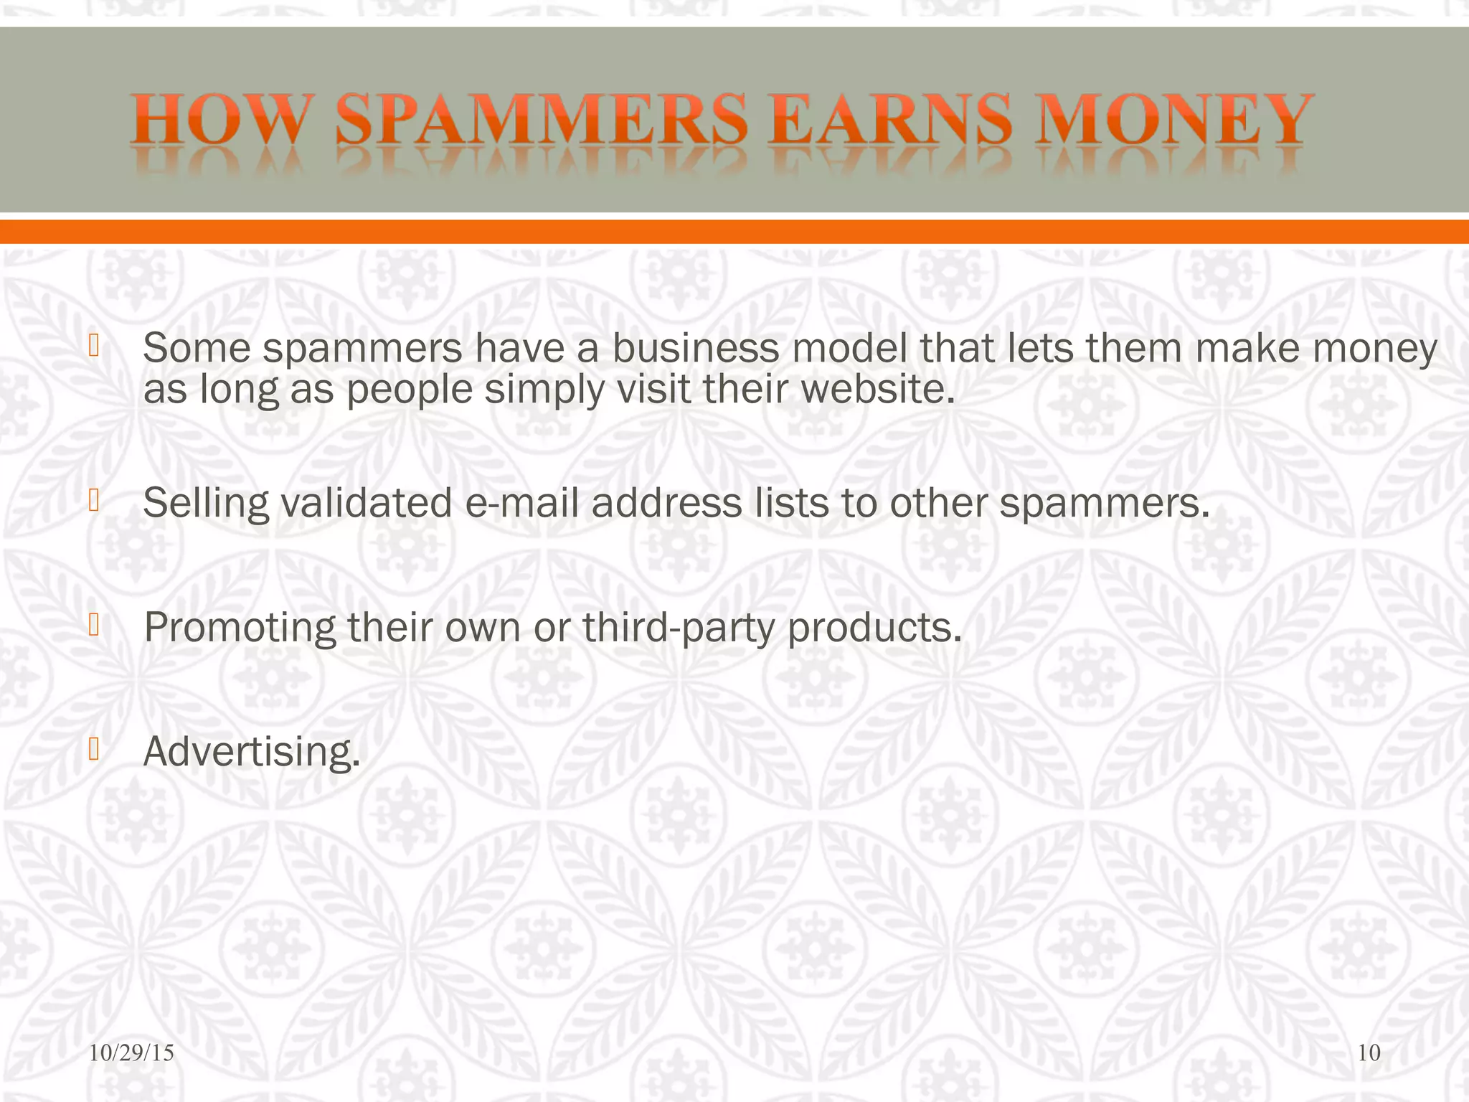
Cyber Security Concepts
Social Engineering and Malware
SPAM

Slide 18
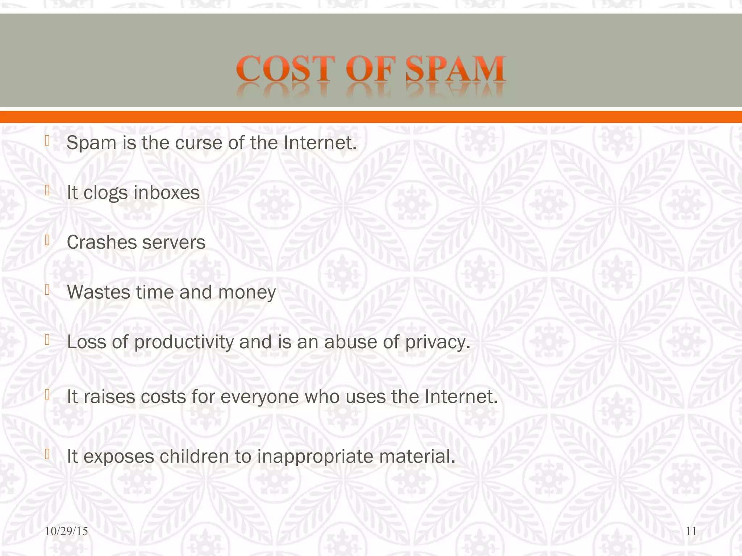
Cyber Security Concepts
Social Engineering and Malware
SPAM

Slide 19
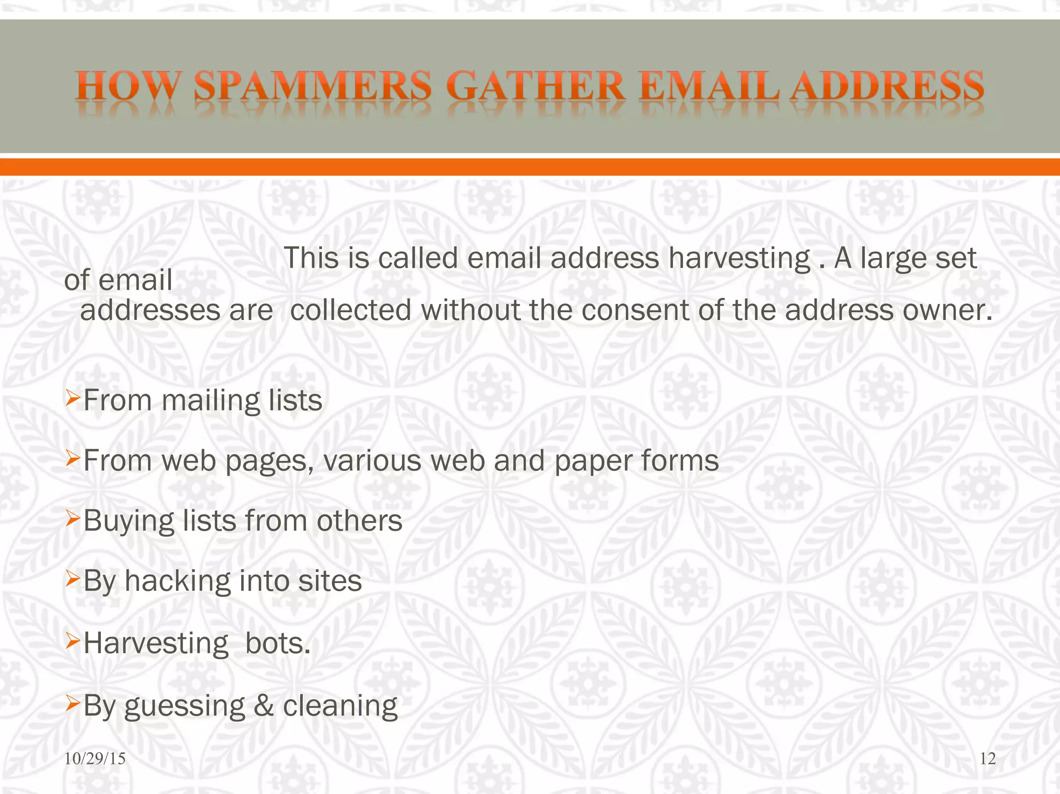
Cyber Security Concepts
Social Engineering and Malware
SPAM

Slide 20
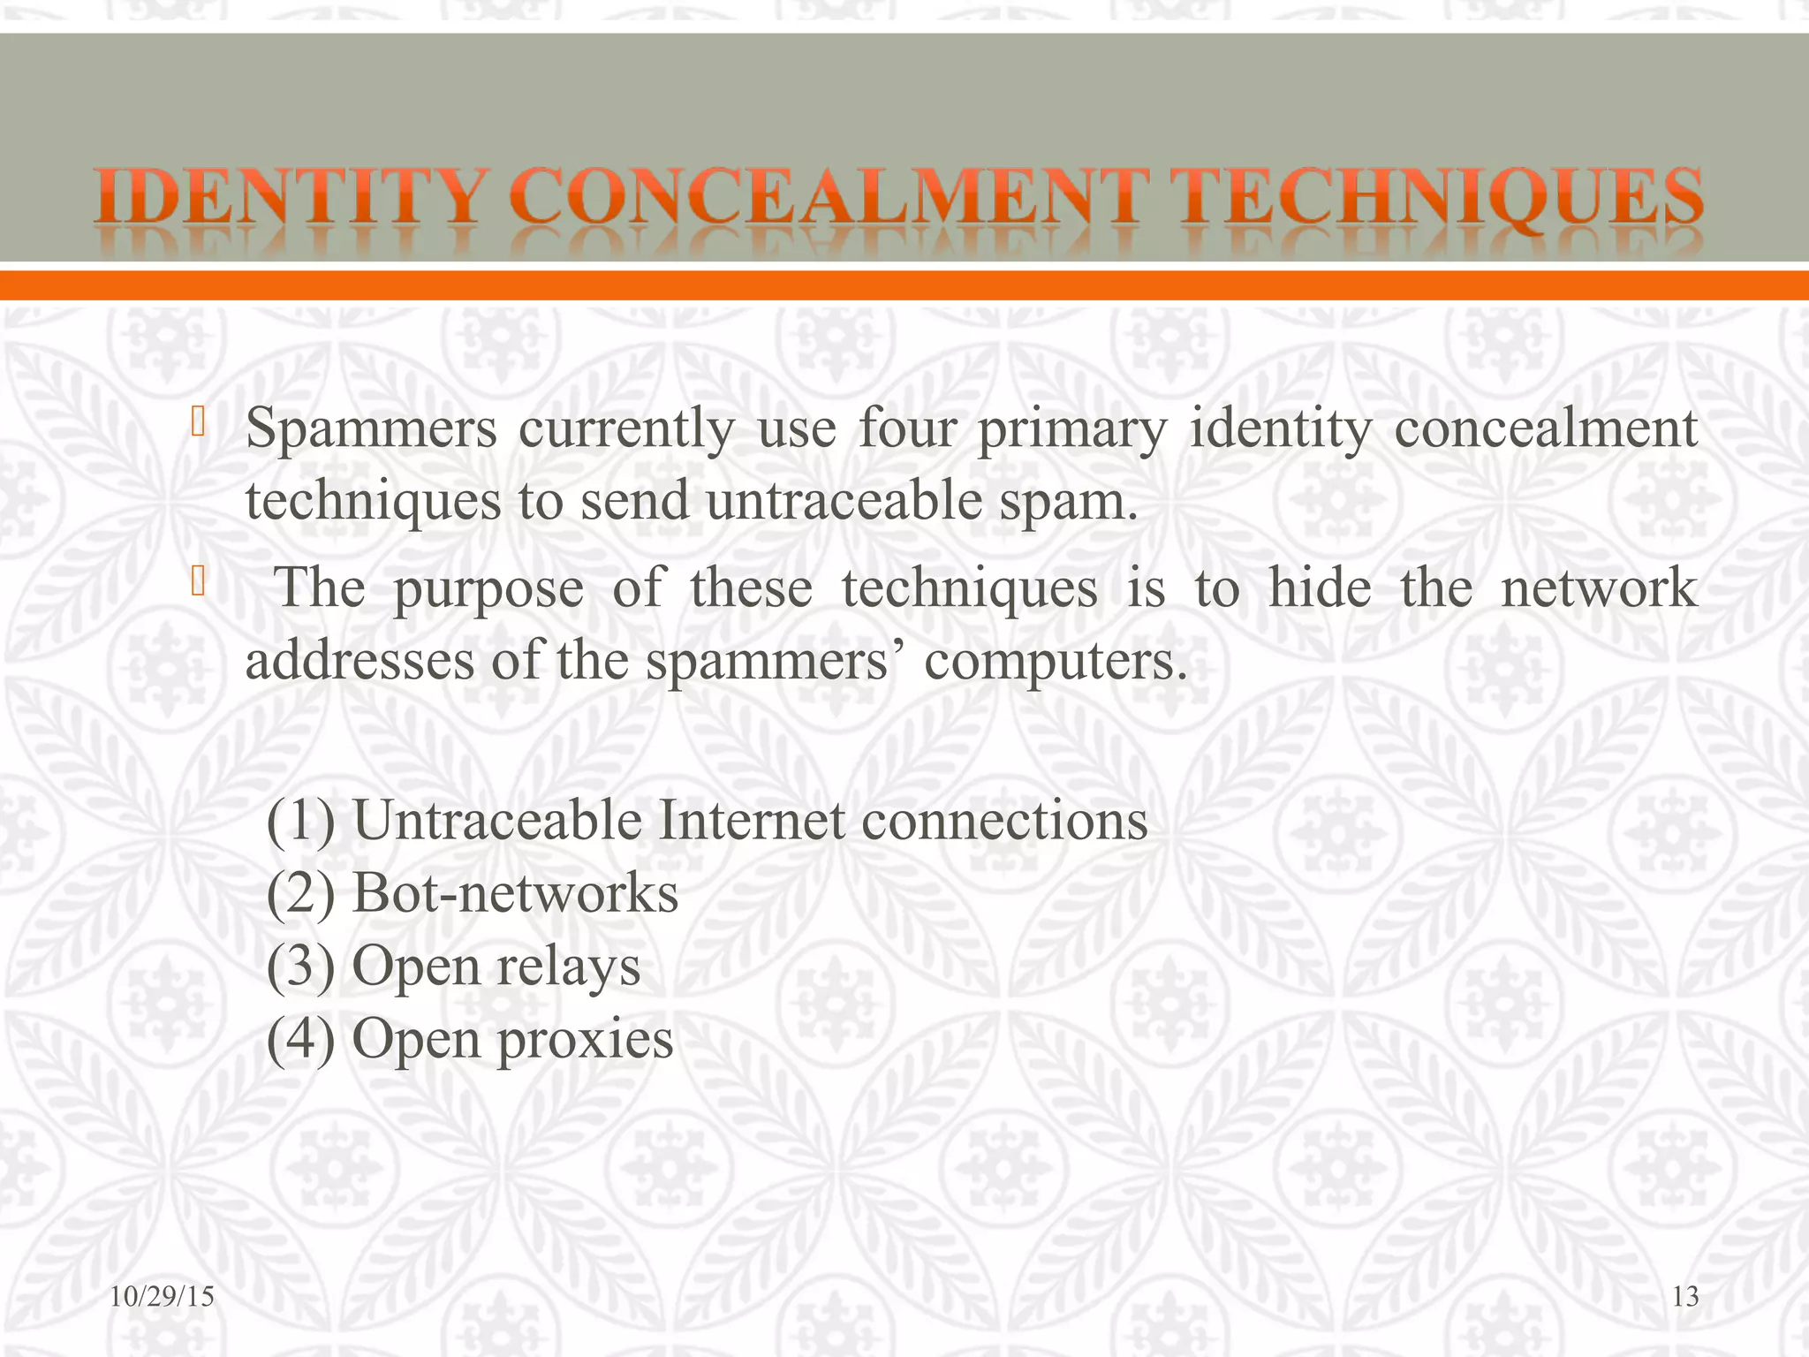
Cyber Security Concepts
Social Engineering and Malware
SPAM

Slide 21
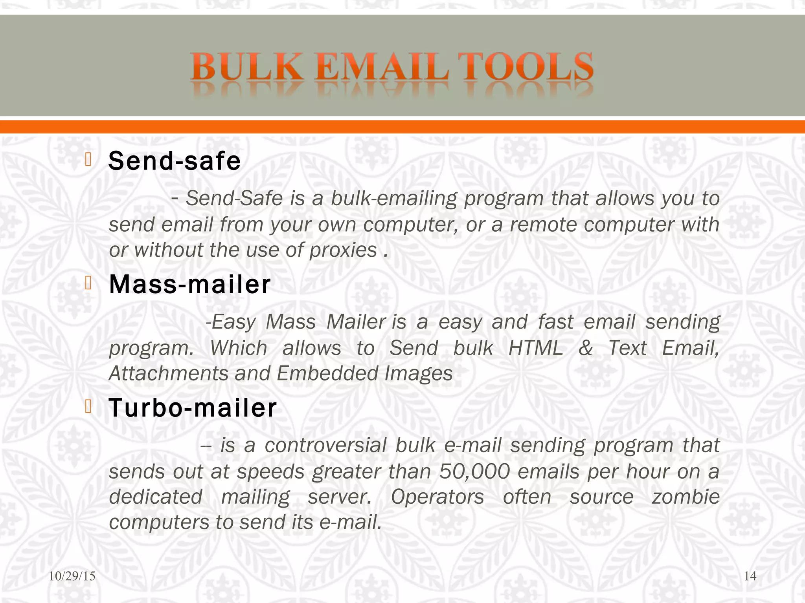
Cyber Security Concepts
Social Engineering and Malware
SPAM

Slide 22
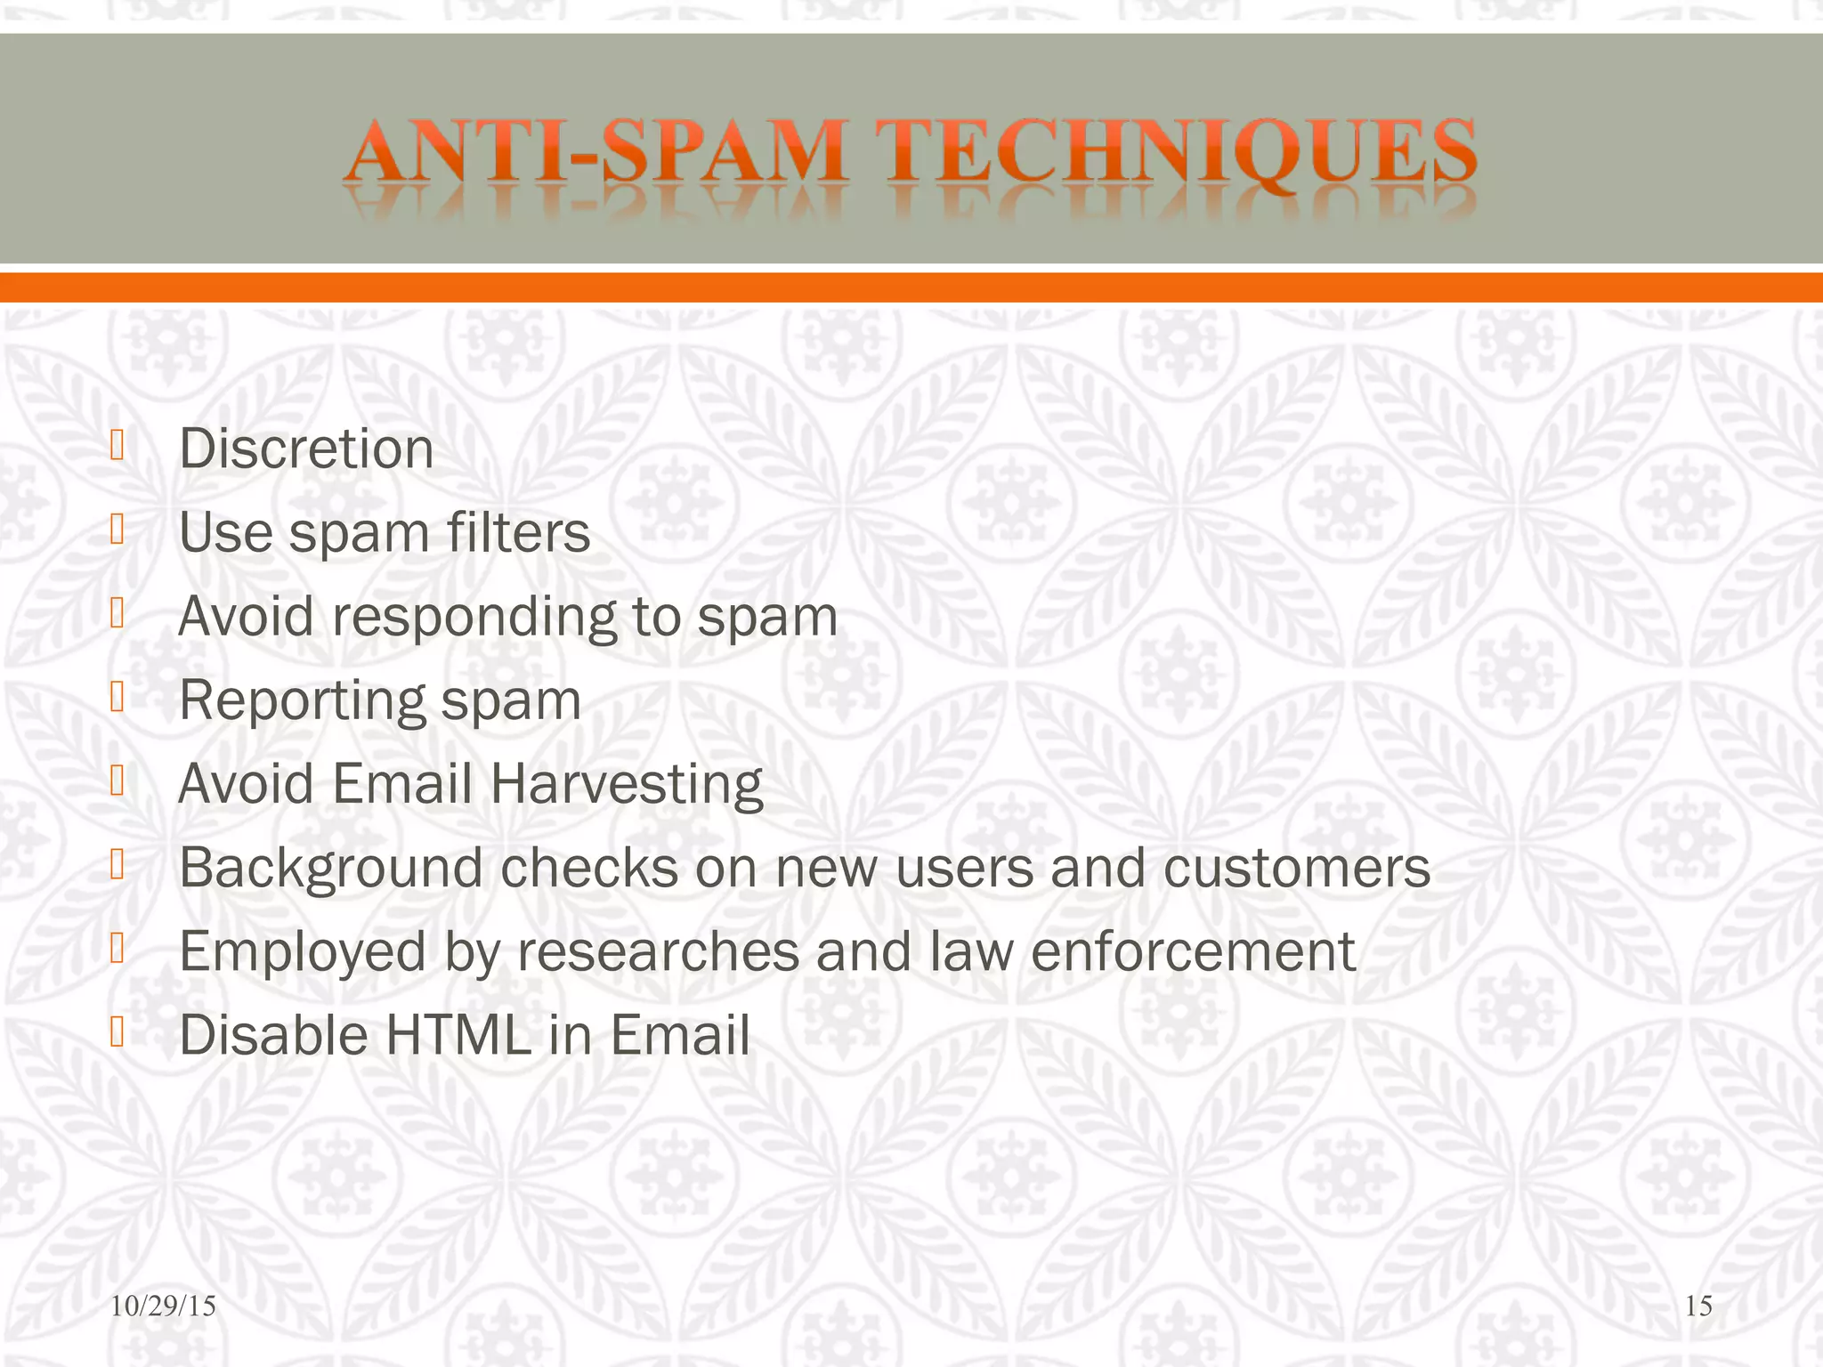
Cyber Security Concepts
Social Engineering and Malware
SPAM

Slide 23
Cyber Security Concepts
Social Engineering and Malware
Dumpster Diving
What is Dumpster Diving?
Somewhere or the other, you might have heard a popular proverb: “One man’s trash is another man’s treasure.” This proverb seems to fit 100% when talking about dumpster diving.
Dumpster Diving Definition: Dumpster Diving is a passive attack in which a hacker searches trash in order to find useful information about a person or an organization that can be used for malicious activities, such as hacking.

Slide 24
Cyber Security Concepts
Social Engineering and Malware
Dumpster Diving
What is Dumpster Diving?
Somewhere or the other, you might have heard a popular proverb: “One man’s trash is another man’s treasure.” This proverb seems to fit 100% when talking about dumpster diving.
Dumpster Diving Definition: Dumpster Diving is a passive attack in which a hacker searches trash in order to find useful information about a person or an organization that can be used for malicious activities, such as hacking.

Slide 25
Cyber Security Concepts
Social Engineering and Malware
Dumpster Diving
Dumpster Diving Attack Example
Suppose a well know organization is migrating from one place to another because of some requirements. While they were in the process of migration, they decided to dump all the unnecessary documents and old computers in a dumping area that was not far from their initial place.
The documents and the dumped electronic devices contained sensitive information, such as employee IDs, company transactions done over the last few years, and so on. A cybercriminal or an attacker decided to dive into the dumpster to find useful information. And, by chance, he found the documents that contained the email ID of the employees.

Slide 26
Cyber Security Concepts
Social Engineering and Malware
Dumpster Diving
Dumpster Diving Attack Example
Once he has found such sensitive information, he can use it for malicious purposes, such as hacking. He can use a phishing or social engineering attack that can trick an employee into releasing confidential information or even giving access to his machine. Attackers can even use the information for other criminal activities, such as identity theft or fraud.

Slide 27
Cyber Security Concepts
Social Engineering and Malware
Dumpster Diving
What Type of Information Can a Hacker Find?
Personal information: Hackers can find discarded papers or documents containing personal information such as names, addresses, phone numbers, social security numbers, or dates of birth. This information can be used for identity theft or other types of fraud.
Financial information: Dumpster diving can also yield financial information such as bank statements, credit card statements, or invoices. This information can be used to make fraudulent purchases or gain unauthorized access to accounts.

Slide 28
Cyber Security Concepts
Social Engineering and Malware
Dumpster Diving
What Type of Information Can a Hacker Find?
Passwords and log-in credentials: Sometimes, people write down their passwords or log-in credentials on paper and then throw them away. Hackers can find this information and use it to access online accounts or company networks.
Confidential documents: Companies sometimes discard confidential documents containing business plans, trade secrets, or sensitive customer information. Hackers can use this information to gain a competitive advantage or to blackmail individuals or companies.
Technology devices: Sometimes, people may throw their old laptops, smartphones, or other devices without properly wiping their data. Hackers can retrieve the data and use it for malicious purposes.

Slide 29
Cyber Security Concepts
Social Engineering and Malware
Dumpster Diving
How to Prevent Dumpster Diving Attack?
Here are some steps you can take to significantly reduce the risk of a dumpster diving attack and protect your sensitive information:
Use encryption: Use encryption to protect sensitive data stored on laptops, smartphones, or other devices.
Use strong passwords: Use secure passwords and do not write them down or store them in an easily accessible location.

Slide 30
Cyber Security Concepts
Social Engineering and Malware
Dumpster Diving
How to Prevent Dumpster Diving Attack?
Educate your employees: Ensure they know the dangers of dumpster diving attacks and train them to properly dispose of sensitive information.
Implement a clean desk policy: Encourage employees to keep their desks clean and tidy and avoid leaving sensitive documents or information in the open.
Secure your trash or recycling bins: Lock them so only authorized personnel can access them. This will prevent unauthorized access to your trash and recycling.

Slide 31
Cyber Security Concepts
Social Engineering and Malware
Dumpster Diving
How to Prevent Dumpster Diving Attack?
Use secure disposal methods: Use a secure disposal service that destroys sensitive documents and materials. They will ensure that the materials are destroyed completely and irretrievably.
Shred sensitive documents: Use a shredder to destroy any papers or documents containing personal, financial, or confidential information. This will make it much harder for a hacker to organize the information.

Slide 32
Cyber Security Concepts
Social Engineering and Malware
Shoulder Surfing
A shoulder Surfing Attack is a social engineering technique where an attacker simply looks over someone’s shoulder to get confidential information. It could be as simple as when a person is entering their PIN in an ATM or when a person is entering the username and password to their social media account/Internet Banking etc. A shoulder surfer could just be a person or sometimes it could be sophisticated video cameras, binoculars, CCTV, and Spy cameras to spy over the victim and steal their confidential information

Slide 33
Cyber Security Concepts
Social Engineering and Malware
Shoulder Surfing
When Does Shoulder Surfing Happen?
At an ATM: You're getting cash at an ATM. You feel safe because the man behind you is 10 feet away, looking at his phone. In reality, he's recording your finger movements to decipher your PIN.
At work: Whether you're in an open office area or a meeting room, someone might casually look over your shoulder and view what you're typing or reading. For example, you could be filling out employment forms on a computer in the human resources office while a nearby coworker views you entering your Social Security number or other sensitive information.

Slide 34
Cyber Security Concepts
Social Engineering and Malware
Shoulder Surfing
When Does Shoulder Surfing Happen?
At the airport: Your flight is delayed, so you grab your laptop to do some online shopping. Excited to find an item you want is on sale, you don't notice the woman nearby staring at your screen as you input your credit card information.
At a restaurant or bar: While waiting for your date at a crowded restaurant, you log on to Instagram. The person next to you catches you entering your password, which happens to be the same one for your email and bank accounts.

Slide 35
Cyber Security Concepts
Social Engineering and Malware
Shoulder Surfing
How to Prevent Shoulder Surfing Attacks?
1. Enable 2-factor authentication
Always enable 2-factor authentication, like an OTP, approval on your mobile device, or usage of Microsoft/Google authenticator apps.
2. Get Physical Obstacle/Shield
While entering a password or an ATM PIN, try to hide it with your body so it is not visible to the person standing behind you. If an OTP, or credit card details must be communicated over the phone, make sure you move away to a place where nobody can listen to the conversations.

Slide 36
Cyber Security Concepts
Social Engineering and Malware
Shoulder Surfing
How to Prevent Shoulder Surfing Attacks?
3. Never login to shared devices
Never login to any of your accounts using public computers like in airports, train stations, libraries or it could be a display device in an electronic gadget store. Confidential information can be stolen.
4. Never use public Wi-Fi
It is advised not to use public unprotected Wi-Fi networks to log in to any personal accounts like social media, banks, and shopping sites. The traffic can always be monitored especially when the Wi-Fi connection uses the weakest protocol WEP.

Slide 37
Cyber Security Concepts
Social Engineering and Malware
Shoulder Surfing
How to Prevent Shoulder Surfing Attacks?
5. Privacy shield
Use privacy filters/shields on laptops and smartphones where the display on the screens can be seen in only one direction.
6. Stop using the same passwords
Many of them use the same password for multiple accounts. Doing so can risk other accounts being compromised as well. Always try to use a different password for different accounts.

Slide 38
Cyber Security Concepts
Social Engineering and Malware
Shoulder Surfing
How to Prevent Shoulder Surfing Attacks?
7. Use alternative methods
Wherever it is possible utilize biometric authentications like a fingerprint and face recognition to log in to laptops, smartphones, and applications.
8. Use password managers
Using password manager applications, one does not have to create a password, the password manager creates a lengthy random string and stores it. When a password is required, one does not have to type any password as the password manager logs in for you.

Slide 39
Cyber Security Concepts
Social Engineering and Malware
Pharming
What is pharming?
Pharming is a type of social engineering cyberattack in which criminals redirect internet users trying to reach a specific website to a different, fake site. These “spoofed” sites aim to capture a victim’s personally identifiable information (PII) and log-in credentials, such as passwords, social security numbers, account numbers, and so on, or else they attempt to install pharming malware on their computer. Pharmers often target websites in the financial sector, including banks, online payment platforms, or e-commerce sites, usually with identity theft as their ultimate objective

Slide 40
Cyber Security Concepts
Social Engineering and Malware
Pharming
How does pharming work?
Pharming exploits the foundation of how internet browsing works — namely, that the sequence of letters that form an internet address, such as www.google.com, have to be converted into an IP address by a DNS server for the connection to proceed.
Pharming attacks this process in one of two ways:
First, a hacker may send malicious code in an email which installs a virus or Trojan on a user's computer. This malicious code changes the computer’s hosts file to direct traffic away from its intended target and toward a fake website instead. In this form of pharming – known as malware-based pharming – regardless of whether you type the correct internet address, the corrupted hosts file will take you to the fraudulent site instead.

Slide 41
Cyber Security Concepts
Social Engineering and Malware
Pharming
How does pharming work?
Second, the hacker may use a technique called DNS poisoning. DNS stands for “Domain Name System” – pharmers can modify the DNS table in a server, causing multiple users to visit fake websites instead of legitimate ones inadvertently. Pharmers can use the fake websites to install viruses or Trojans on the user's computer or attempt to collect personal and financial information for use in identity theft.
While DNS servers are harder to attack because they sit on an organization’s network and behind its defenses, DNS poisoning can affect a significant number of victims and therefore offer great rewards for cybercriminals. Poisoning can also spread to other DNS servers. Any internet service provider (ISP) receiving information from a poisoned server can lead to the corrupted DNS entry being cached on the ISP’s servers – spreading it to more routers and devices..

Slide 42
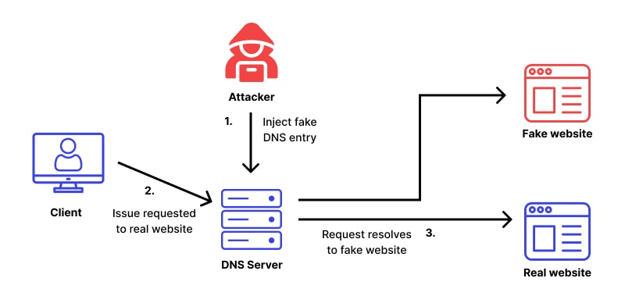
Cyber Security Concepts
Social Engineering and Malware
Pharming
How does pharming work?

Slide 43
Cyber Security Concepts
Social Engineering and Malware
Pharming
How to protect yourself against pharming
Choose a reputable internet service provider (ISP). A good ISP will filter out suspicious redirects by default – ensuring you never reach a pharming website in the first place.
Use a reliable DNS server. For most of us, our DNS server will be our ISP. However, it is possible to switch to a specialized DNS service, which could offer more security against DNS poisoning.
Only follow links that begin with HTTPS – as opposed to just HTTP. The “s” stands for “secure” and indicates that the site has a valid security certificate. Once on the site, check for the padlock icon in the address bar – another indicator that the site is secure.
Don’t click on links or open attachments from unknown senders. While you can't protect yourself from DNS poisoning, you can take care to avoid the malicious software that enables pharming. Avoid clicking on links or opening attachments in any email or message you are unsure of.

Slide 44
Cyber Security Concepts
Social Engineering and Malware
Pharming
How to protect yourself against pharming
Check URLs for typos. Pharmers sometimes use spelling tricks to deceive visitors, by replacing or adding letters to domain names. Look at the URL closely and if you spot a typo – avoid it.
Avoid suspicious-looking websites generally. Aside from the URL, signs to look out for include spelling or grammatical errors, unfamiliar fonts or colors, and missing content – for example, some pharmers don’t bother to populate the privacy policy or terms and conditions. Check that everything is as you would expect before submitting any information.
Avoid deals that appear too good to be true. Online scammers sometimes lure victims with eye-catching deals – for example, discounts much lower than the legitimate competition. If offers seem implausible, then exercise caution.

Slide 45
Cyber Security Concepts
Social Engineering and Malware
Pharming
How to protect yourself against pharming
Enable two-factor authentication where possible. Many platforms offer two-factor authentication, and when this is available, it's a good idea to turn it on. This makes your accounts harder to hack into – even if fraudsters have obtained your log-in details through pharming, they won’t be able to access your account.
Change the default settings of your Wi-Fi router. Changing the standard password and using a strong password instead for your private network will help to protect you from DNS poisoning. It is also essential to keep your router up to date. If your router doesn't have automatic updates, consider replacing it with one that does.
Use a robust anti-malware and antivirus solution and keep it up to date. For example, Kaspersky Total Security protects you against hackers, viruses, and malware and works 24/7 to secure your devices and data.

Slide 46
Cyber Security Concepts
Social Engineering and Malware
Pharming
How to protect yourself against pharming
Enable two-factor authentication where possible. Many platforms offer two-factor authentication, and when this is available, it's a good idea to turn it on. This makes your accounts harder to hack into – even if fraudsters have obtained your log-in details through pharming, they won’t be able to access your account.
Change the default settings of your Wi-Fi router. Changing the standard password and using a strong password instead for your private network will help to protect you from DNS poisoning. It is also essential to keep your router up to date. If your router doesn't have automatic updates, consider replacing it with one that does.
Use a robust anti-malware and antivirus solution and keep it up to date. For example, Kaspersky Total Security protects you against hackers, viruses, and malware and works 24/7 to secure your devices and data.

Slide 47
Keep Learning
Thank You!

